Slide 1



Ethics in IT
Class X
lab 3

Slide 2


Wireless Hacking
accessing the wireess network
allows a hacker to take any
crucial step for any system which
is connected to wirless network

Slide 3
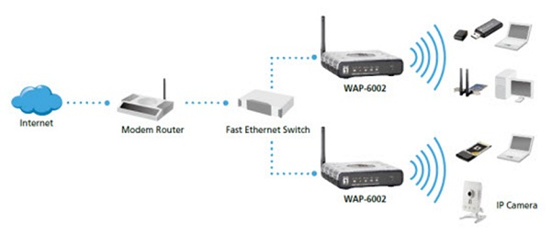
Wireless Network

Slide 4

Kismet
a powerful tool for
wireless sniffing

Slide 5
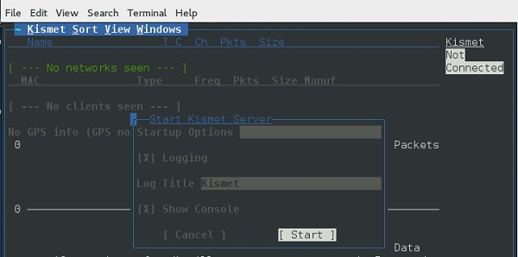
Kismet
sniffing
wireless
network

Slide 6
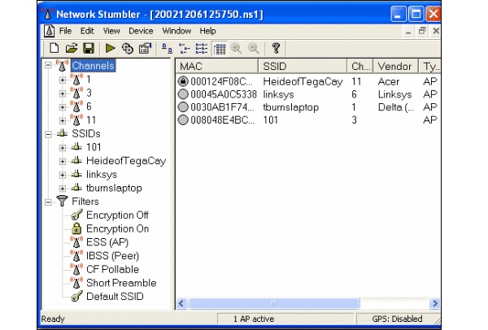
NetStumbler
NetStumbler is another tool for wireless hacking

Slide 7

Wired Equivalent Privacy
a security protocol that was invented to secure wireless networks and keep them private

Slide 8
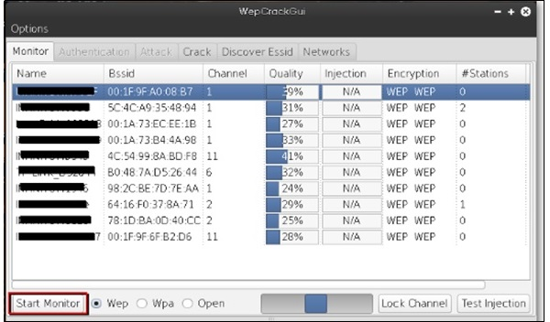
WEPcrack
WEPcrack is a popular tool to crack WEP passwords

Slide 9
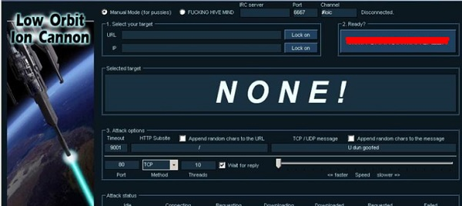
Wireless DoS Attacks
Low Orbit Ion Cannon
is an open-source network
stress testing and
denial-of-service attack
application

Slide 10



